Slide 1
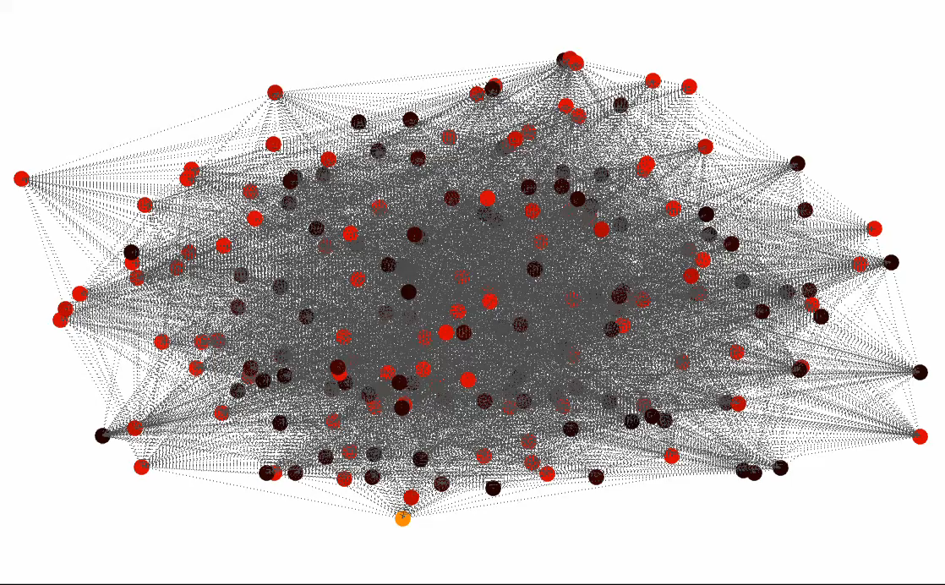


Spectral Analysis of Network Data
Luca Trevisan
Bocconi University
Image credit: James R Lee

Slide 2
Network Analysis: Finding Clusters

Slide 3
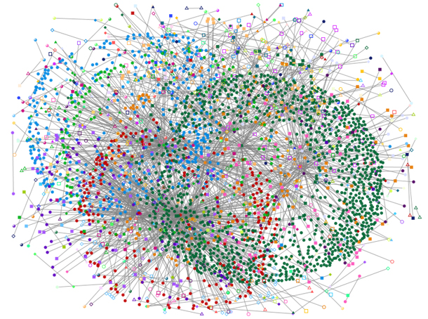
Some data sets present themselves as networks:
”friend” or “follower” relations in social networks
parties in a transactions (credit card data, cryptocurrency transactions)
calls, texts and DMs in messaging apps
Image credit: Microsoft Research

Slide 4
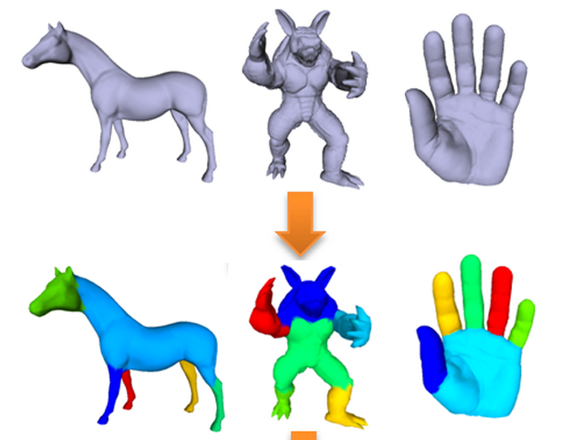
Arbitrary data sets may be turned into networks in order to apply network data analysis tool, e.g. by creating a network that has
A node per data point
An edge between each pair of data points that are ”close” in a certain metric
[image credit: Ma-Wu-Luo-Feng 2011]
image credit: Ng-Jordan-Weiss, 2001]

Slide 5


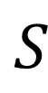
Conductance of a graph
$$S$$
$$Φ\left(S\right)=\frac{\left|E\left(S\right)\right|}{\left|vol(S)\right|}$$
$$Φ^{∗}\left(G\right)=\min_{vol(S)≤\frac{V}{2}}{Φ\left(S\right)}$$

Slide 6
Conductance of a graph
Low conductance sets:
In image segmentation nodes are pixels, edges are between nearby pixels likely to be in same feature
A low-conductance set is a set of pixels more likely to be in same feature with each others than with other pixels
[photo credit: Ma-Wu-Luo-Feng 2011]

Slide 7
Conductance of a graph
Low conductance sets:
In data analysis nodes are data points, edges are between data points close in feature space
A low-conductance set is a set of data items more similar to each other than to the rest of the data set
Photo credit: Ng-Jordan-Weiss, 2001]

Slide 8
Conductance of a graph
Low conductance sets:
In a social network a low-conductance set is a set of users that are mostly friends with one another
$$S$$

Slide 9
Spectral Algorithms

Slide 10
Spectral graph algorithms workflow
Start from a graph

Slide 11
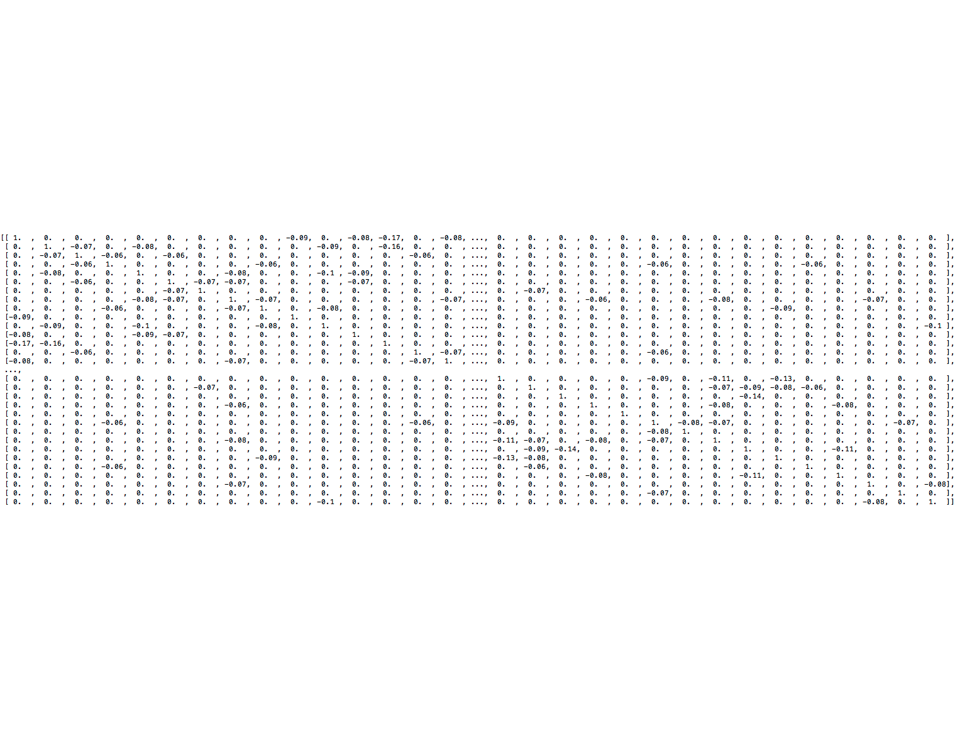
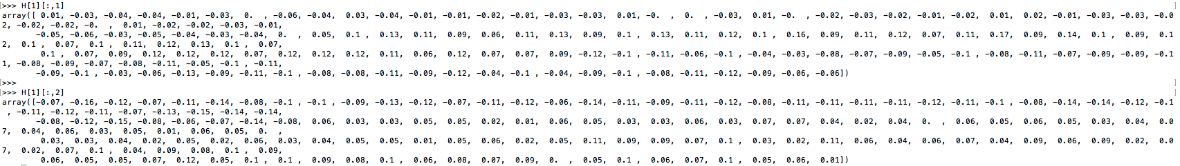
Spectral graph algorithms workflow
Associate a matrix to the graph and compute its eigenvalues and eigenvectors

Slide 12

Spectral graph algorithms workflow
Use low-energy eigenvectors to embed graph in $ℝ^{k}$

Slide 13
Spectral graph algorithms workflow
Ignore edges

Slide 14
Spectral graph algorithms workflow
Cluster points geometrically (e.g. K-means)

Slide 15
Spectral graph algorithms workflow
Done!

Slide 16
Linear algebra and graph algorithms
Define Laplacian matrix L, then:
Eigenvalues
Graph properties
Eigenvectors
Cuts, clustering
Optimization view:
Eigenvectors are solutions of optimization problems (variational characterization) …
… which are relaxations of combinatorial cut, flow and clustering problems
Constructive proofs in spectral graph theory are rounding algorithms

Slide 17
New Challenges in Spectral Algorithms

Slide 18
Spectral algorithms
Work well in practice both to find clusters and to find data visualizations
Work well in theory (both worst-case and average-case rigorous analysis)
Have some corner cases in which do not perform well
Fix some of these cases with pre-processing?
Are efficient but not on peta-scale graphs
Rigorous analysis of multi-scale methods?

Slide 19
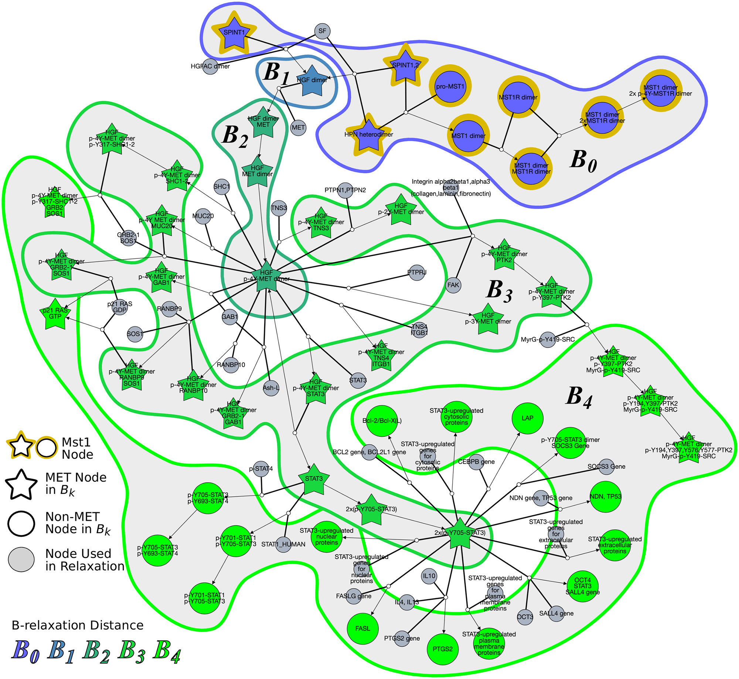
Hypergraphs
A graph describes relations between pairs of data points
A hypergraph describes relations between arbitrary subgroups:
Items bought together in one purchase
People in a conference call
Words co-occurring in a sentence
Image credit: PLOS Computational Biology

Slide 20
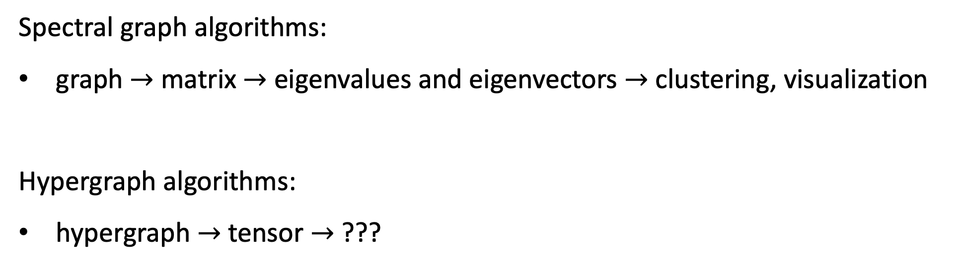
Hypergraph analysis
Spectral graph algorithms:
graph $→$ matrix $→$ eigenvalues and eigenvectors $→$ clustering, visualization
Hypergraph algorithms:
hypergraph $→$ tensor $→$ ???

Slide 21
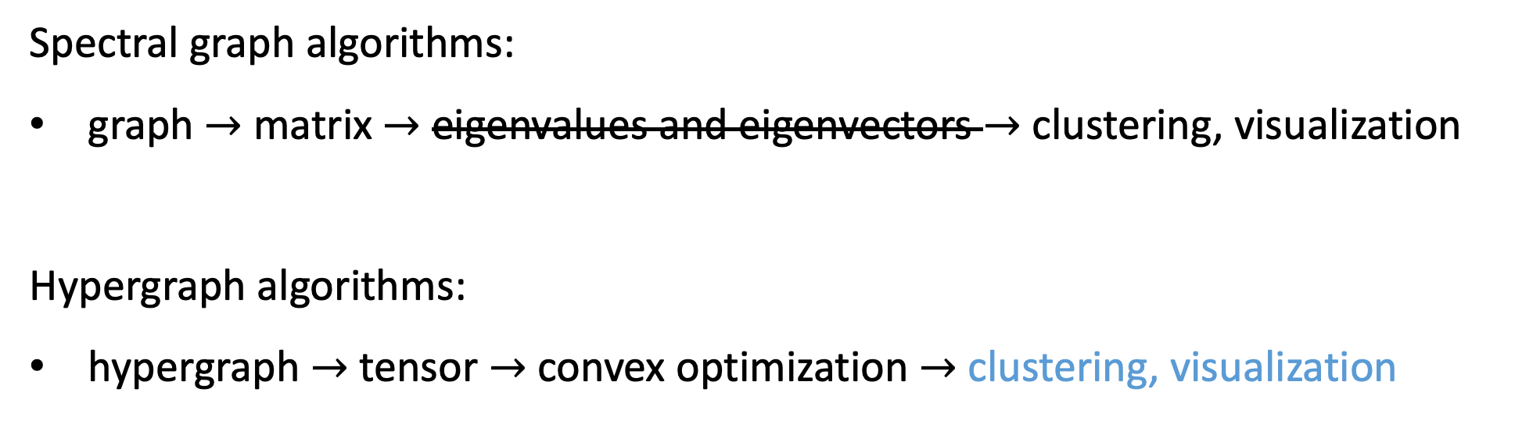
Hypergraph analysis
Spectral graph algorithms:
graph $→$ matrix $→$ eigenvalues and eigenvectors $→$ clustering, visualization
Hypergraph algorithms:
hypergraph $→$ tensor $→$ convex optimization $→$ clustering, visualization
convex optimization

Slide 22
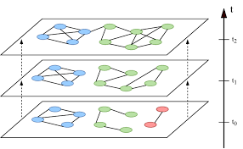
Temporal graphs
Network data is usally collected as a time series of graphs
What are good notions of clusters in temporal graphs?
What insights from spectral algorithms apply here?

